Slide 1

Email Template
Gihiyeon
Erjon
Shahferoz

Slide 2

Inhoud
Taakverdeling
Design
Onderwerp A
Onderwerp B
Onderwerp C

Slide 3
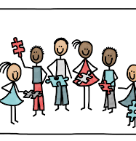
Taakverdeling
Gihiyeon & Shahf = Figma
Erjon = Web Text

Slide 4
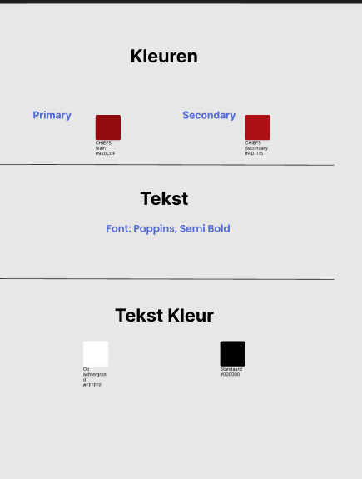
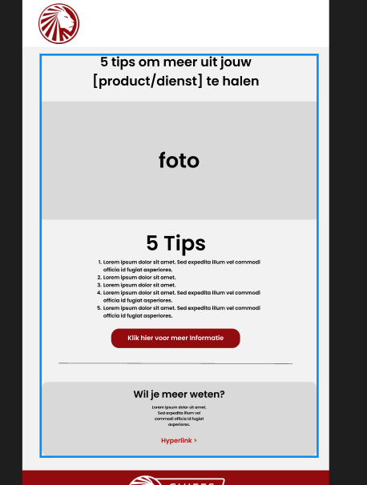
Design

Slide 5
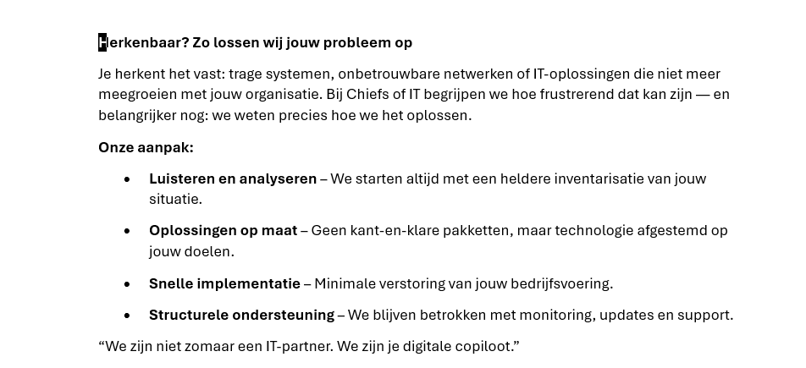
Onderwerp A

Slide 6
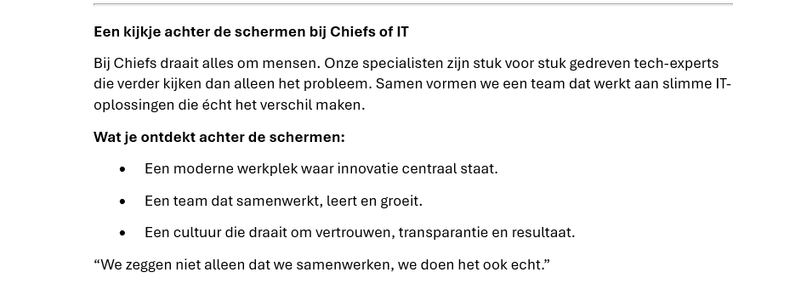
Onderwerp B

Slide 7
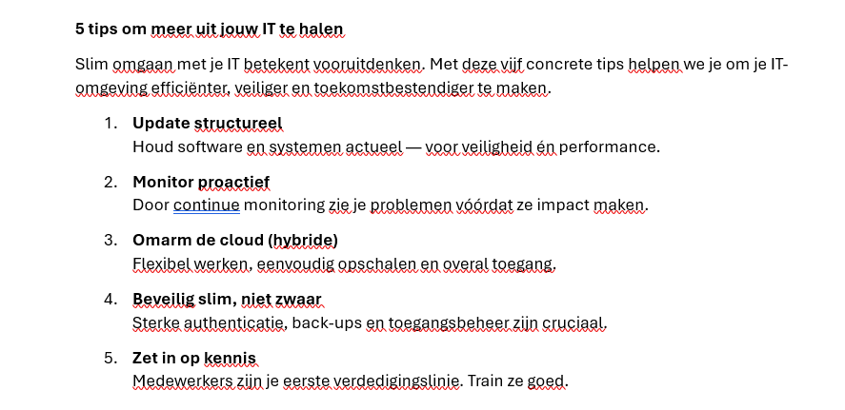
Onderwerp C

